Slide 1
Decision Trees
Y.LAKSHMI PRASAD
08978784848

Slide 2
Objectives
What is Classification
Parametric Vs Nonparametric Models
Introduction to Decision Trees
Decision Tree Terminology
Building Decision Trees
Purity measures of Decision Trees
Different decision Tree Algorithms
Advantages and Limitations of decision trees.

Slide 3
What is Classification?
PARTITIONING the (FEATURE) SPACE into PURE REGIONS assigned to each CLASS.

Slide 4
Parametric Vs Non- Parametric Models
A parametric model is Learning a fixed Number of parameters. In Linear Regression, as well as Logistic regression, If we given 1 feature to the model, we are sure that the model is learning 2 parameters i.e., Intercept and Slope.
Whereas a non parametric model may learn more or less number of parameters based on the given data. Examples: KNN, Decision Tree, SVM with Kernels

Slide 5
Examples for Parametric Models
Linear Regression
Logistic Regression
NaiveBayes

Slide 6
Benefits of Parametric ML Algorithms
Simpler: These methods are easier to understand and interpret results.
Speed: Parametric models are very fast to learn from data.
Less Data: They do not require as much training data and can work well even if the fit to the data is not perfect.

Slide 7
Limitations of Parametric ML Algorithms
Constrained: By choosing a functional form these methods are highly constrained to the specified form.
Limited Complexity: The methods are more suited to simpler problems.
Poor Fit: In practice the methods are unlikely to match the underlying mapping function.

Slide 8
Examples for Non-Parametric Models
K-Nearest Neighbours
Decision Trees like CART and C4.5

Slide 9
Benefits Nonparametric ML Algorithms
Flexibility: Capable of fitting a large number of functional forms.
Power: No assumptions (or weak assumptions) about the underlying function.
Performance: Can result in higher performance models for prediction.

Slide 10
Limitations of Nonparametric ML Algorithms
More data: Require a lot more training data to estimate the mapping function.
Slower: A lot slower to train as they often have far more parameters to train.
Over-fitting: More of a risk to overfit the training data and it is harder to explain why specific predictions are made.

Slide 11
Introduction to Decision trees
Decision tree uses a tree-like model to make predictions. It resembles an upside-down tree. It is also very similar to how you make decisions in real life: you ask a series of questions to arrive at a decision.
A decision tree splits the data into multiple sets. Then, each of these sets is further split into subsets to arrive at a decision.

Slide 12
Introduction to Decision trees
High interpretability and an intuitive algorithm, decision trees mimic the human decision-making process and excel in dealing with categorical data.
Unlike other algorithms such as logistic regression, decision trees do not find a linear relationship between the independent and the target variable. Rather, they can be used to model highly nonlinear data.
With decision trees, you can easily explain all the factors leading to a particular decision/prediction. Hence, they are easily understood by business people.

Slide 13
Introduction to Decision trees
As a rule of thumb, if interpretability by laymen is what you're looking for in a model, decision trees should be at the top of your list.

Slide 14
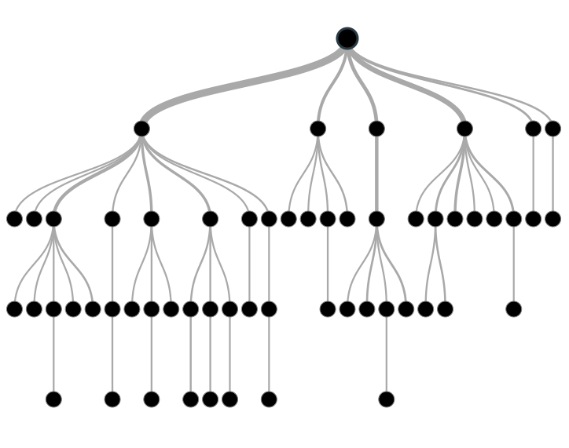
Decision Tree

Slide 15
Decision Tree- Terminology
1. A decision tree uses a tree structure to specify sequences of decisions and consequences.
2. The input values of a decision tree can be categorical or continuous.
3. A decision tree employs a structure of nodes and branches, represent the decision being made. A decision node has two or more branches.
4. The topmost decision node in a tree which corresponds to the best predictor called root node.
5. A node without further branches is called a leaf node. The leaf nodes represent the final decisions.

Slide 16
Decision Tree- Terminology
Decision trees use a very natural decision-making process: asking a series of questions in a nested if-then-else structure.

Slide 17
Decision Tree- Types
1. Decision trees have two varieties: classification trees and regression trees.
2. Classification trees usually apply to output variables that are categorical such as yes or no, purchase or not purchase, and so on.
3. Regression trees, can apply to output variables that are numeric or continuous, such as the predicted price of a consumer good or the likelihood a subscription will be purchased.

Slide 18
Data Pre-process
1. Re-code multi-category targets into a 1-of-N scheme - make each binary
2. Convert dates and time data into a computable form
3. Avoid information loss
4. Define the target Variable.
5. Identify the Predictor Variables.
6. Understand correctly the missing value.
7. Partition data into train and validation datasets.

Slide 19
How to create Decision trees
1. Find the Split: Identify all possible split options, Choose the best split.
2. Grow the tree: Continue growing the tree till it meets a criterion. Grow the tree large and prune it.
3.Prune the tree: Create candidate sub-trees. Identify best candidate.
4. Extract Rules: Generate rule set corresponding to the tree, simplify the rules.

Slide 20
Basic modelling steps
1. Bring the data into your environment
2. Understand the data(data Exploration)
3. Deal with missing Values and Outliers (Data manipulation)
4. Choose the algorithm
5. Choose the Purity metric
6. Build Basic model
7. Choose the Hyper parameters
8. Choose you features (Complexity)
9. Perform Feature engineering
10. Rebuild the Model

Slide 21
Decision Tree steps
The leaf nodes represent the final decisions.
Each intermediate node represents a simple test on one of the attributes.
The path from the root to a leaf corresponds to a conjunction of tests at each of the nodes on the path.
We say a test data point ’follows a path’ on a decision tree if it passes all the tests on the path in the decision tree.
The branches out of an intermediate node are exclusive — the test data point can follow exactly one branch out of every intermediate node it encounters.
The prediction by a decision tree on a data point is the one corresponding to the leaf at which the path followed by the data point ends.

Slide 22
Concept of Homogeneity
Given 10 attributes, how do you decide which attribute to split on first? Should you randomly select an attribute and split the data set on it?
Or should there be a selection criterion to choose a particular attribute ahead of the other nine attributes?
So try to do the best you can, i.e. try to split the nodes such that the resulting nodes are as homogenous as possible.
Always try to generate partitions that result in homogeneous data points. For classification tasks, a data set is completely homogeneous if it contains only a single class label.

Slide 23
Concept of Homogeneity
So you go step-by-step, picking an attribute and splitting the data such that the homogeneity increases after every split. You stop splitting when the resulting leaves are sufficiently homogenous.
What is sufficiently homogenous? Well, you define the amount of homogeneity which, when achieved, the tree should stop splitting further.

Slide 24
Purity Metrics for Decision Trees
GINI coefficient
Entropy (Information Gain)
Reduction in Variance (MSE)

Slide 25
“Toy” Dataset
Consider a dataset of toys given by three attributes:
COLOR = {Red, Green, Blue},
SHAPE = {Square, Circle, Triangle}
LIKE = {Yes, No} of whether a kid likes the toy or not.
#EXAMPLES | COLOR | SHAPE | LIKE = Y | LIKE = N
30 | Red | Square | 15 | 15
10 | Red | Circle | 0 | 10
20 | Red | Triangle | 15 | 5
10 | Green | Square | 10 | 0
30 | Green | Circle | 20 | 10
10 | Green | Triangle | 5 | 5
20 | Blue | Square | 5 | 15
20 | Blue | Circle | 15 | 5
30 | Blue | Triangle | 30 | 0

Slide 26
Partition this!
 | Red | Blue | Green | TOTAL
Circle | 0 / 10 | 5 / 20 | 0 / 30 | 5 / 60
Square | 15 / 15 | 10 / 15 | 15 / 10 | 40 / 40
Triangle | 20 / 5 | 30 / 0 | 10 / 5 | 60 / 10
TOTAL | 35 / 30 | 45 / 35 | 25 / 45 | 105 / 110
R(?, ?)
105 / 110
R(Cir, ?)
5 / 60
R(Sqr, ?)
40 / 40
R(Tri, ?)
60 / 10
R(?, ?)
105 / 110
Which is a “better” partition?
What is “purity” of a partition?
R(?, Red)
35 / 30
R(?, Blu)
45/ 35
R(?, Gre)
25/ 45

Slide 27
Gini Index
Gini coefficient, sometimes called Gini index, or Gini ratio, is a measure of statistical dispersion intended to represent the income or wealth distribution of a nation's residents, and is the most commonly used measurement of inequality.

Slide 28
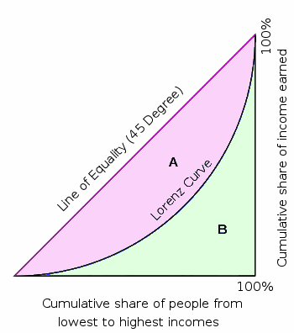
Lorenz Curve

Slide 29
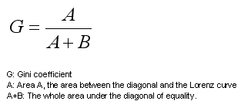
Gini Coefficient

Slide 30
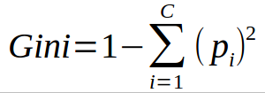
Gini-Measure of Inequality

Slide 31
Gini Index
In a Gini based decision tree algorithm, we therefore find the split that maximizes the weighted sum (weighted by the size of the partition) of the Gini indices of the two partitions created by the split.
So Lower the Gini index higher the homogeneity.

Slide 32
Gini Index
Favours larger partitions.
Uses squared proportion of classes.
Perfectly classified, Gini Index would be zero.
Evenly distributed would be 1 – (1/ No. Of Classes).
You want a variable split that has a low Gini Index.

Slide 33
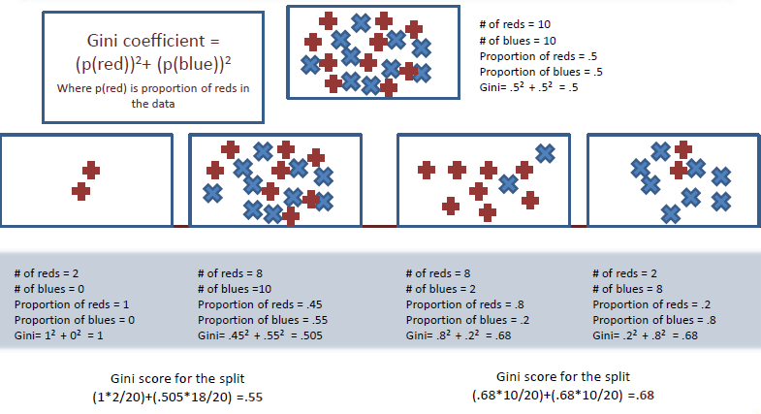
GINI Index

Slide 34
GINI Index
Let us use a simple hypothetical example of people in an organization and we want to build a model for who among them plays football.
Each employee has two explanatory attributes Gender and Age.
The target attribute is whether they play football.
The numbers against P and N indicate the numbers of employees who play football and those who don’t respectively, for each combination of gender and age.

Slide 35
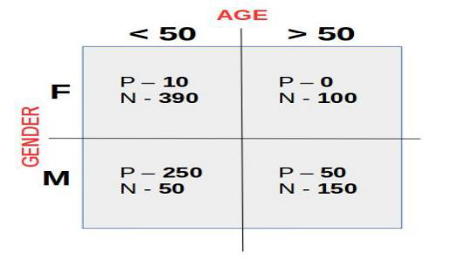
GINI Index

Slide 36
Gini Index
There are 1000 employees in total. Let's say, you split the data on gender. On splitting, you get two nodes with 500 observations each, call them male-node and female-node.
In the male-node, 300/500 play football. In the female node, only 10/500 play football.
Gini index of male-node = 1- P(play football)^2 + P(doesn't play football)^2 = 1- (0.6)^2 + (0.4)^2 = 0.48.

Slide 37
Gini Index
What is the Gini index of female-node?
A) 1- (0.02)^2 + (0.6)^2
B) 1- (0.02)^2 + (0.98)^2
C) 1- (0.6)^2 + (0.98)^2
D) 1- (0.98)^2 + (0.4)^2

Slide 38
Feedback
Answer B: Feedback :The probability that a female plays football = 0.02 and the probability that a female doesn't play football = 0.98.

Slide 39
Gini Index on Gender
Split on gender: the two partitions will have 10/500 and 300/500 as the probabilities of finding a football player respectively. Each partition is half the total population.
The total Gini index if you split on gender will be
Gini Index(gender) = (fraction of total observations in male-node)*Gini index of male-node + (fraction of total observations in female-node)*Gini index of female-node.

Slide 40
Gini Index on Age
Split on Age: the two partitions will have 260/700 and 50/250 as the probabilities, and 700 and 300 as the sizes respectively.

Slide 41
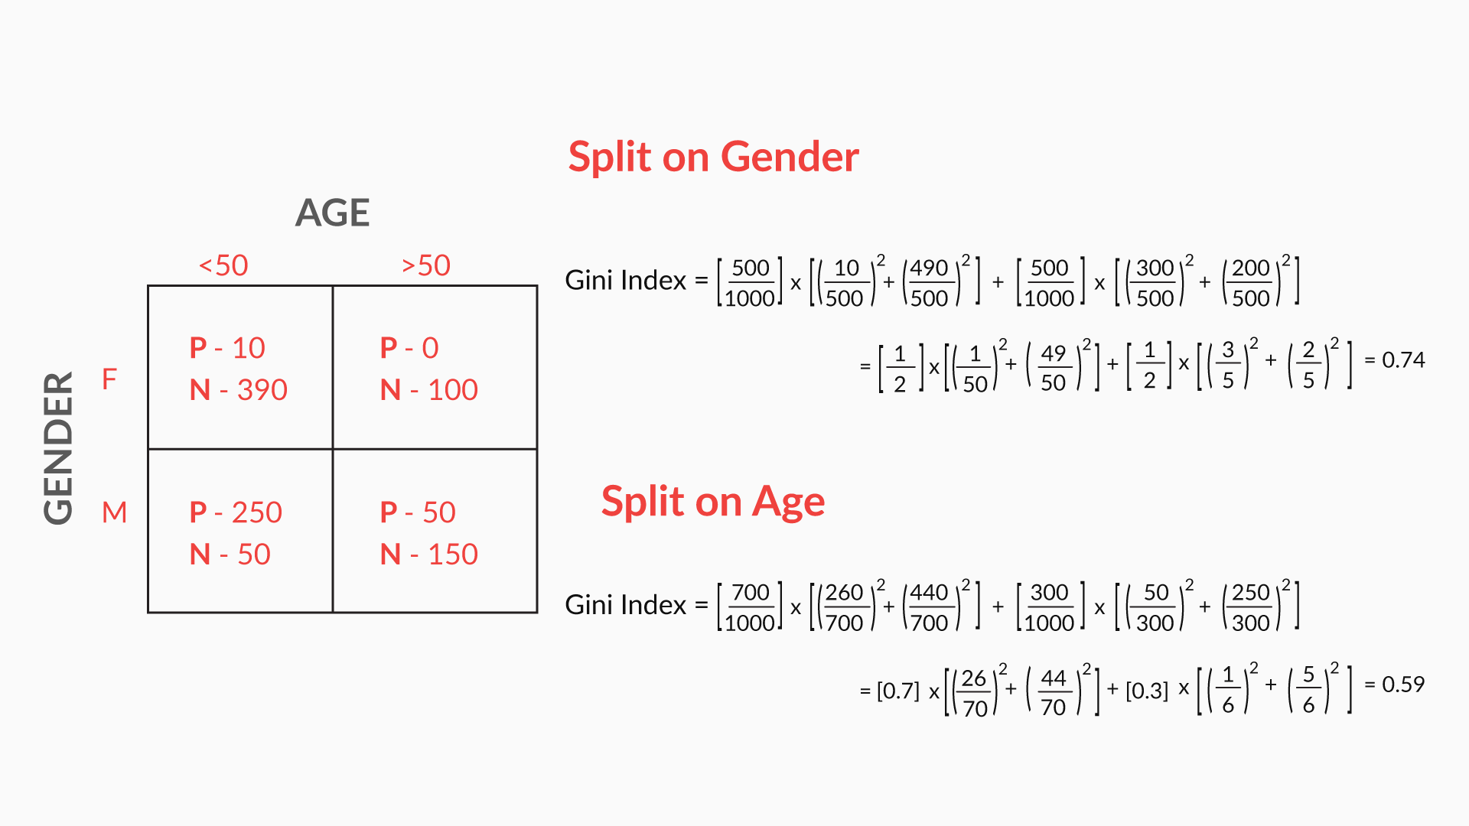
Gini Calculation

Slide 42
Which feature to use for split?
Therefore we would first need to split on the gender, this split gives a higher GINI index for the partitions.
Gini index can only be used on classification problems where the target attribute is Binary.

Slide 43
Entropy
Entropy which is a central concept in information theory.
Entropy quantifies the degree of disorder in the data.
Entropy is always a positive number between zero and 1.
Another interpretation of entropy is in terms of information content.
A completely homogeneous dataset has no information content in it, whereas a dataset with a lot of disorder has a lot of latent information waiting to be learnt.

Slide 44
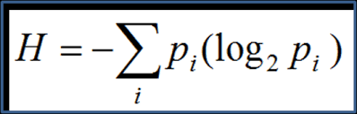
Entropy

Slide 45
Entropy
Favours splits with small counts but many unique values.
Weights probability of class by log(base=2) of the class probability
A smaller value of Entropy is better. That makes the difference between the parent node’s entropy larger.
Information Gain is the Entropy of the parent node minus the entropy of the child nodes.

Slide 46
Information Gain
The information gain is based on the decrease in entropy after a dataset is split on an attribute.
Constructing a decision tree is all about finding attribute that returns the highest information gain (i.e., the most homogeneous branches).
Information gain measures how much the entropy has decreased between the parent set and the partitions obtained after splitting.

Slide 47
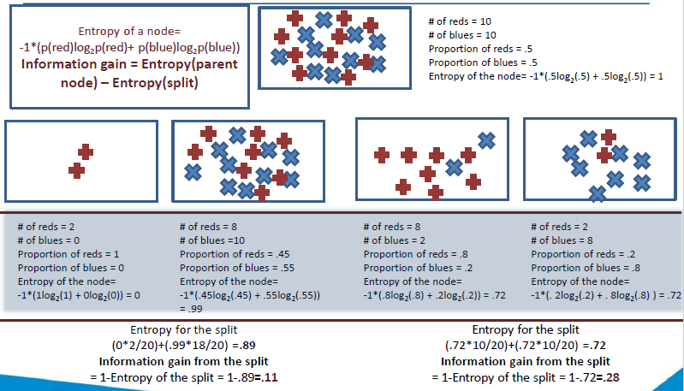
Information Gain

Slide 48
Information Gain
When is the information gain maximum? (Select the most appropriate option.)
A) When the decrease in entropy, from the parent set to the partitions obtained after splitting, is maximum.
B) When the decrease in entropy, from the parent set to the partitions obtained after splitting, is minimum.

Slide 49
Feedback
Answer A: Feedback :The information gain is equal to the entropy change from the parent set to the partitions. So it is maximum when the entropy of the parent set minus the entropy of the partitions is maximum.

Slide 50
Regression with Decision Trees
There are cases where you cannot directly apply linear regression to solve a regression problem.
Linear regression will fit only one model to the entire data set; whereas you may want to divide the data set into multiple subsets and apply linear regression to each set separately.
In regression problems, a decision tree splits the data into multiple subsets.
The difference between decision tree classification and decision tree regression is that in regression, each leaf represents a linear regression model, as opposed to a class label.

Slide 51
Splitting by R-squared
How is splitting done for continuous output variables?
We calculate the R-Square of data sets (before and after splitting) in a similar manner to what you do for linear regression models. So split the data such that the R-Square of the partitions obtained after splitting is greater than that of the original or parent data set.
In other words, the fit of the model should be as ‘good’ as possible after splitting.

Slide 52
Regression
Select all that is correct about decision tree classification and regression models.(More than one correct answer )
A) Leaves in classification contain labels.
B) Leaves in regression contain labels.
C) Leaves in classification contain models.
D) Leaves in regression contain models.

Slide 53
Feedback
A) Leaves in classification contain labels.
Feedback :In classification, the target variable is discrete. Hence, each data point in a leaf has an associated class label.
D) Leaves in regression contain models.
Feedback :True. Each leaf in regression contains a model that is used to make predictions

Slide 54
Reduction in Variance
Variance reduction is often employed in cases where the target variable is continuous (regression tree), meaning that use of many other metrics would first require discretization before being applied.
The variance reduction of a node N is defined as the total reduction of the variance of the target variable, due to the split at this node

Slide 55
DT- Regression- Test your understanding
Which homogeneity measure is used in tree regression?
A) Gini Index
B) Information gain
C) R-Square
D) Entropy

Slide 56
Feedback
Feedback :R-Square is used to measure the homogeneity in regression, where the target variable is continuous.

Slide 57
Constructing a DT-Test our Understanding
Arrange the following steps in the order of their occurrence:
1) Now that the R2 is sufficiently high, stop splitting.
2) You have a data set, D, with categorical as well as numerical attributes and continuous target variables. So it is a regression problem. Hence, you apply decision tree regression to it.
3) Split the original data set, D, on the selected attribute.
4) After selecting the homogeneity measure, you need to decide the first attribute to split the original data set, D, on.
5) Keep on splitting the subsequent data sets till you get a sufficiently high R2.
6) Select a homogeneity measure for splitting. Since it is regression, let’s choose R2.
7) Each leaf will now represent a linear regression model.
8) Split ‘D’ on all the attributes one by one, and select the attribute that results in the maximum increase in homogeneity after splitting.

Slide 58
Choose the correct order
A) 6, 2, 8, 1, 7, 4, 3, 5
B) 2, 6, 4, 8, 3, 5, 1, 7
C) 2, 6, 4, 8, 3, 1, 5, 7
D) 3, 2, 8, 5, 1, 7, 4, 6

Slide 59
Feedback
Answer B: Feedback :First, decide if it’s a classification problem or a regression problem. Then, select a homogeneity measure for splitting, and select the first attribute for splitting out of the many.
After this, split the original data set on the selected attribute, and keep splitting till you get a sufficiently high R2. Once you stop splitting, you will get leaves containing linear regression models.

Slide 60
GREEDY Decision Tree Algorithm
A
a1
a2
a3
C
E
B
c1
c2
e1
e2
e3
b1
b2
b3
E
B
C
e1
e2
e3
b1
b2
b3
c1
c2

Slide 61
OVERFITTING
A
a1
a2
a3
C
E
B
c1
c2
e1
e2
e3
b1
b2
b3
E
B
C
e1
e2
e3
b1
b2
b3
c1
c2

Slide 62
PRUNNING
A
a1
a2
a3
C
E
B
c1
c2
e1
e2
e3
b1
b2
b3
C
c1
c2

Slide 63
The “Right-Sized” Tree
Top-Down Stopping Rules (Pre-Pruning)
Node size
Tree depth
Statistical significance
Bottom-Up Selection Criteria (Post-Pruning)
Accuracy
Profit
Class-probability trees
Least squares

Slide 64
Regularization in Decision trees
There are broadly two ways of regularization on decision trees:
Truncate the decision tree during the training (growing) process preventing it from degenerating into one with one leaf for every data point in the training dataset. One or more stopping criteria are used to decide if the decision tree needs to be grown further.
Let the tree grow to any complexity. However add a post-processing step in which we prune the tree in a bottom-up fashion starting from the leaves. It is more common to use pruning strategies to avoid over-fitting in practical implementations.

Slide 65
Decision Tree Stopping Criteria (Truncation)
There are several ways to truncate decision trees before they start to overfit.
1. Minimum Size of the Partition for a Split: Stop partitioning further when the current partition is small enough.
2. Minimum Change in Homogeneity Measure: Do not partition further when even the best split causes an insignificant change in the purity measure (difference between the current purity and the purity of the partitions created by the split).
3. Limit on Tree Depth: If the current node is farther away from the root than a threshold, then stop partitioning further.

Slide 66
Decision Tree Stopping Criteria (Truncation)
4. Minimum Size of the Partition at a Leaf: If any of partitions from a split has fewer than this threshold minimum, then do not consider the split. Notice the subtle difference between this condition and the minimum size required for a split.
5. Maximum number of leaves in the Tree: If the current number of the bottom-most nodes in the tree exceeds this limit then stop partitioning.

Slide 67
Advantages of Decision tree
Easy to understand and Interpret
Able to handle both numerical and categorical data
Require less data preparation than other methods
Non parametric method
Result in form of rules.
Requires little data preparation. Other techniques often require data normalization.
Deal well with outliers and missing values
Performs well with large datasets. Large amounts of data can be analysed using standard computing resources in reasonable time.

Slide 68
Disadvantages
Tendency to over-fit, Decision-tree learners can create over-complex trees that do not generalize well from the training data. Mechanisms such as pruning are necessary to avoid this problem.
Trees can be very non-robust. A small change in the training data can result in a large change in the tree and consequently the final predictions.
May results in too many splits on variables with many values.
For data including categorical variables with different numbers of levels, information gain in decision trees is biased in favour of attributes with more levels.

Slide 69
When to use decision tree?
Very popular classification technique especially when problem is binary
Best option when the interpretation of results is more important than the accuracy
Whenever available, use for initial data exploration in any project
Not the first choice for estimating continuous values

Slide 70
Questions?

